Slide 1
Computer Architecture: Past, Present, and Future
Prof. Smruti R. Sarangi
IIT Delhi

Slide 2

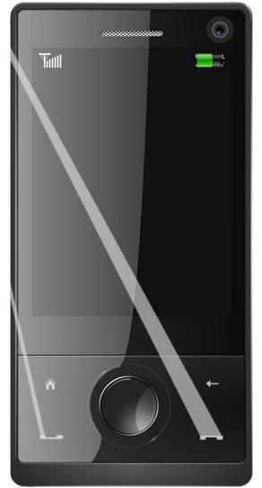

What is computer architecture?
The study of computer processors and computer systems

Slide 3
What does a computer do?
Almost everything:
Financial calculations
Games
Weather forecasting
Connect to friends on the other side of the world
Astrology
...

Slide 4
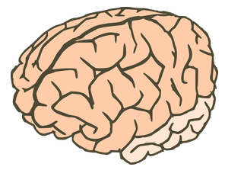
How does it do it?
USB
Monitor
Mouse
Processor (CPU)
Printer
Keyboard
Hard disk
Network
Brain of the computer system

Slide 5

Past
Present
Future

Slide 6

What does a program look like? Historical Perspective
Ever since mathematics was discovered
Man always felt the need for a little bit more of help
Almost all early civilizations had accountants and book keepers
They wrote simple programs (in their mind) to tally accounts, compute expenditures, and forecast future demands
This Photo by Unknown Author is licensed under CC BY-SA-NC

Slide 7
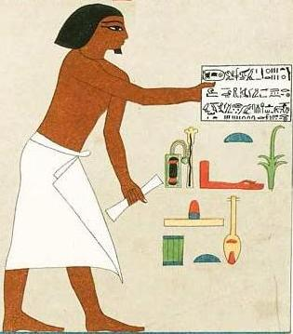
Ancient Accountants
This Photo by Unknown Author is licensed under CC BY-SA

Slide 8
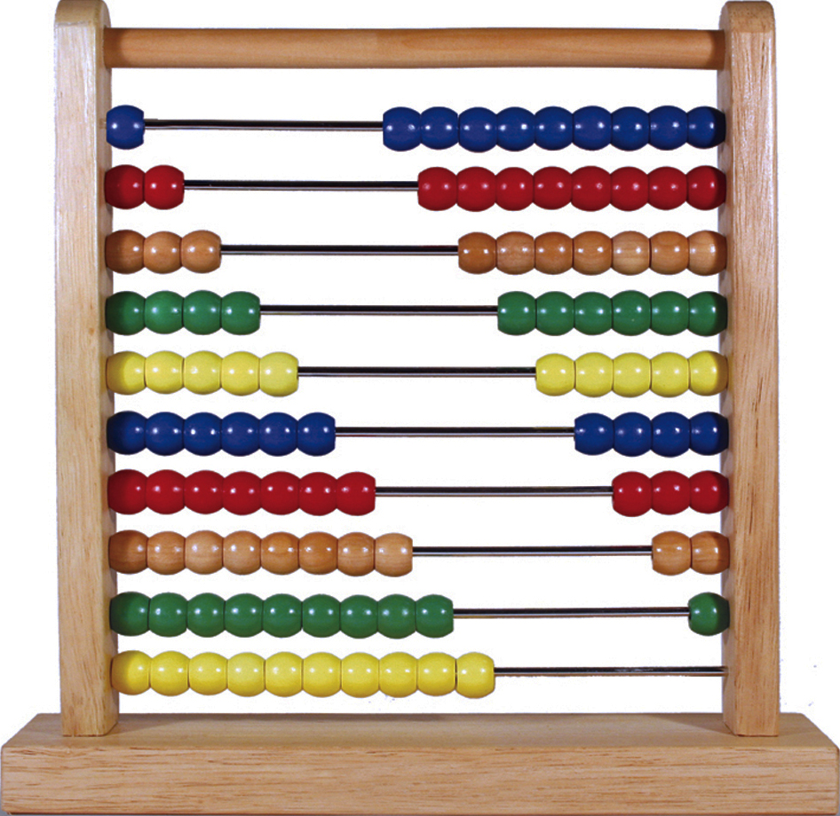
The first real computing machine – Abacus (simple and fast mathematics)
This Photo by Unknown Author is licensed under CC BY-NC-ND

Slide 9
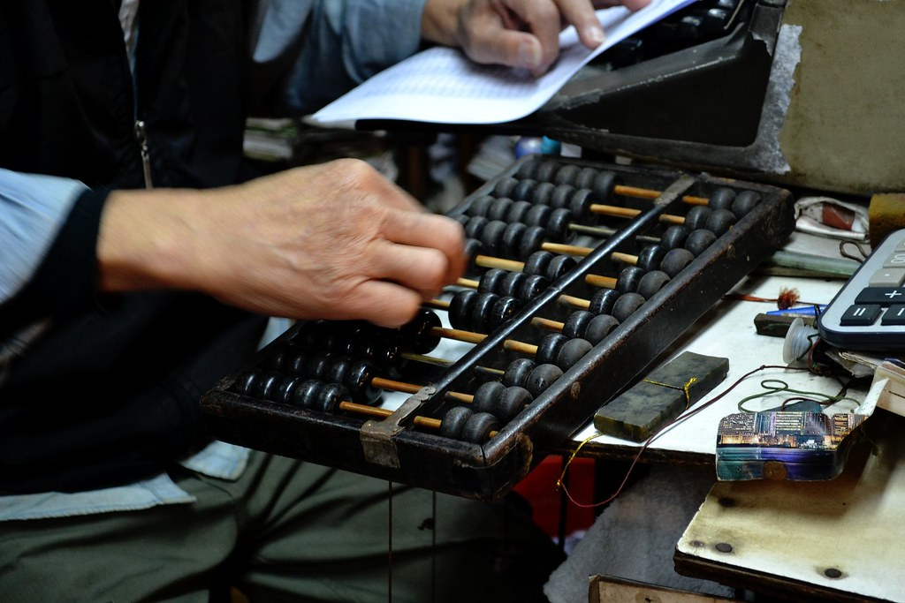
It is still being used!
This Photo by Unknown Author is licensed under CC BY-SA

Slide 10
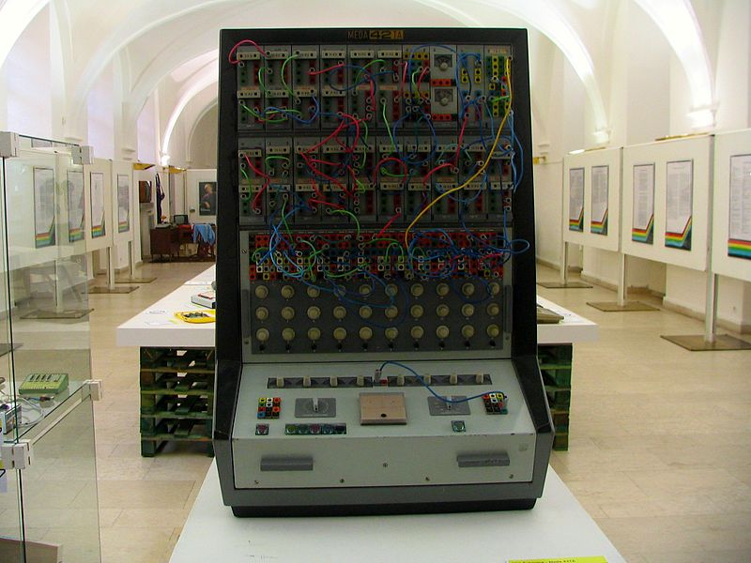
Analog Computers
Wikimedia, Commons

Slide 11
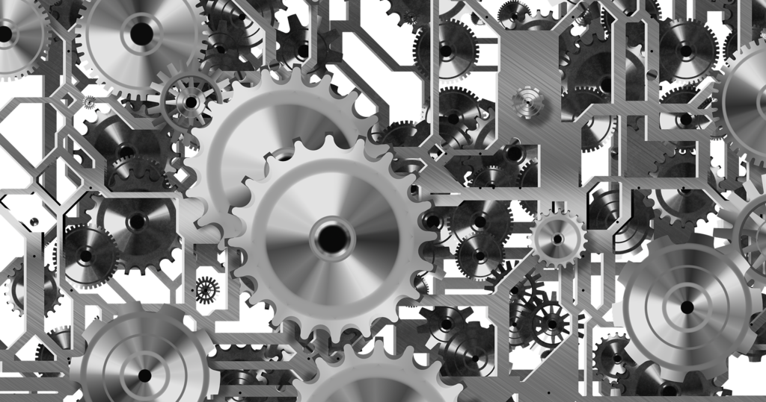
Basic operation
Can be used to compute the ratio r1/r2
Turn one gear r1 times, the other will turn r2 times

Slide 12
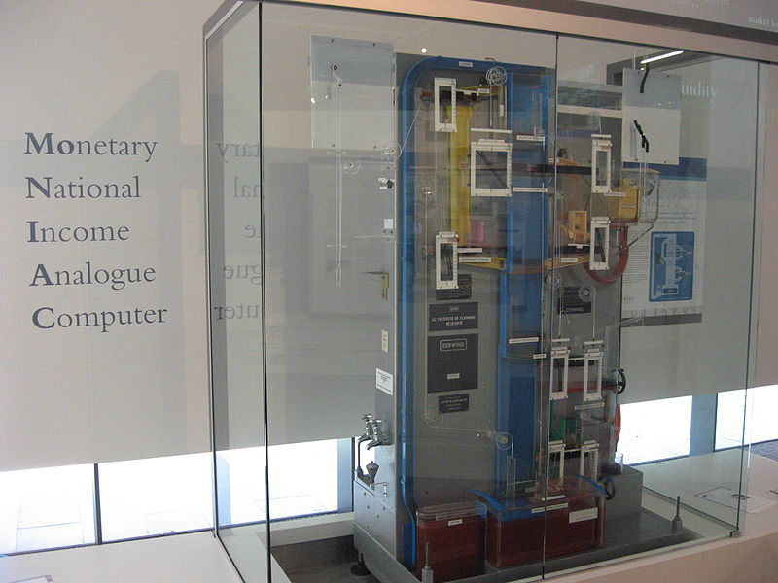
Water computers: Could model the British economy
Source: wikipedia

Slide 13
Basic Methods of Operation
Program
Computer
a = 100
b = 500
result = b / a
Output
Spend energy: move gears, move water, move electrons, move ... → get the result

Slide 14
What was known about computing till 1900 AD
Task (program)
a = 100
b = 500
result = b / a
state
logic
a, b, result
+ - * / exp sin cos

Slide 15

Then came Alan Turing and asked ...
What basic operations do we need to implement any kind of a program?

Slide 16
Church Turing Thesis
A function is computable by a human being using an algorithm if and only if it is computable by a Turing machine
Infinite Tape
Tape head
State Table
1
read the
symbol
access the
state table
write a new
symbol
2
4
move the
tape head left or right
3

Slide 17
Led to the design of the modern computer – Von Neumann, Eckert Mauchly, and others
Memory
CPU
I/O Devices

Slide 18
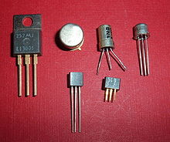

We have the theoretical tools → How do we build a computer
Then came the transistor (1947, Bardeen and Brattain)
Simple 3 pin device.
Acts like a simple
electrically
controlled switch
This Photo by Unknown Author is licensed under CC BY-SA

Slide 19



By the 50s and 60s
Theoretical
Advancements
Technological
Advancements
Era of Computers

Slide 20

Era of Big Computer Corporations
Gordon Moore (co-founder) of Intel proposed the Moore’s Law
The number of transistors per chip will double roughly every year
Has held true for the last 55 years
One year has increased to roughly 2 years

Slide 21

Why does Moore’s law hold?
Transistors get smaller with every new generation
1 micron in 1980 to 14nm in 2016
High Speed
Smaller Transistors
Lower Area
Lower Power

Slide 22
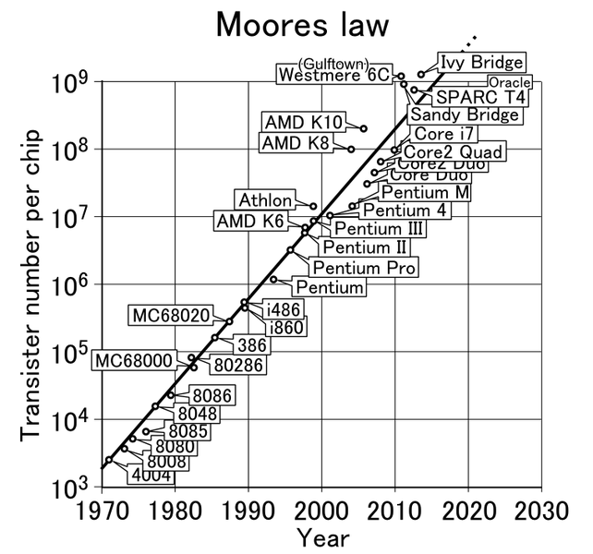
Source: Wikipedia

Slide 23


From 2000 to 2,000,000,000 transistors
What have we gained?
Performance
Equation
Performance $=\frac{IPC ∗frequency}{\#instructions}$
Clock Frequency → increased from 0.5 Mhz to 3 GHz (6000 times)
#instructions in a program → better compiler technology, reduced #insts by at least 2-3X in the last 30 years
IPC → Instructions per cycle

Slide 24
IPC (Basis of Modern Computer Architecture)
Program
n
Processor
n
In the steady state, the processor will take in n instructions every cycle (average), execute them, and complete them
The IPC is equal to n

Slide 25
What determines the IPC?
Processor
Pipeline
Increase the #instructions
it can process per cycle
(average)
100s of techniques
On-Chip Memory System
Increase the hit rate (probability of finding data)
Decrease the access time and power
Off-Chip Memory System
Increase the hit rate (probability of finding data)
Decrease the access time and power

Slide 26

Crux of the techniques: Out of Order Execution
4
3
2
1
Processor

Slide 27
Crux of the techniques: Speculation
Predict a value
Move ahead
If prediction is correct, GREAT
Direction of a branch
Value of a variable
If prediction is wrong
Rollback and Recover
Dependence between instructions
Time it takes to access memory

Slide 28
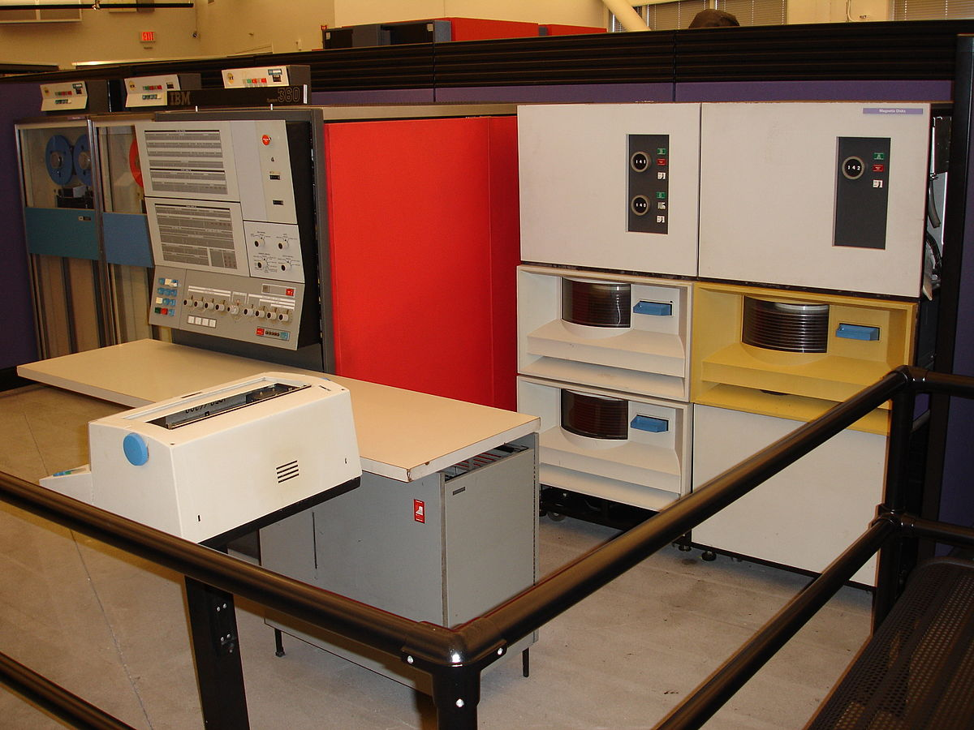
Where did we reach with all these tricks ...
IBM 360
Early 60s
This Photo by Unknown Author is licensed under CC BY-SA

Slide 29
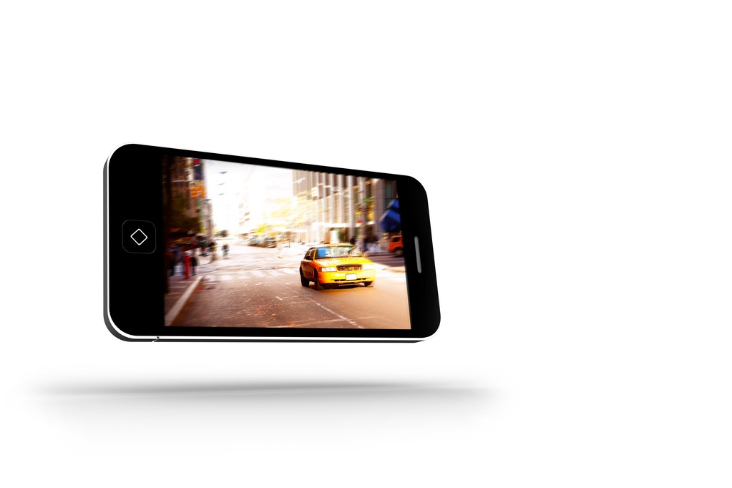
Modern Cellphone

Slide 30

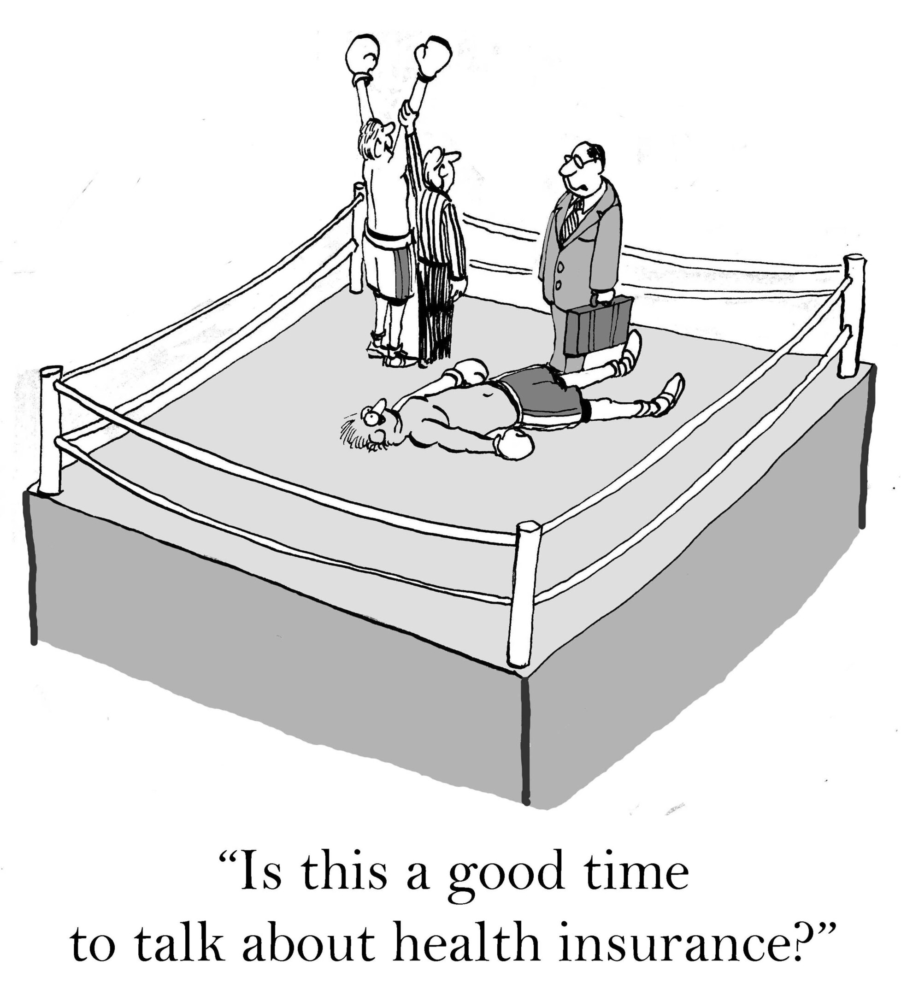
Which computer is faster, and by how many times ...
10,000 times
Samsung S5
IBM 360

Slide 31
Past
Present
Future

Slide 32
Processor Performance Scaling has reached its Limits
6000
5
000
4000
Clock frequency (MHz)
3000
2000
1000
0
29/10/99
12/03/01
25/07/02
07/12/03
20/04/05
02/09/06
15/01/08
29/05/09
11/10/10
23/02/12
Date
Clock frequency has remained constant for the last 10 years

Slide 33
Processor Performance
35
30
25
20
Speclnt 2006 Score
15
40
10
5
0
29/10/99
12/03/01
25/07/02
07/12/03
20/04/05
02/09/06
15/01/08
29/05/09
11/10/10
23/02/12
Date
Performance is also saturating

Slide 34
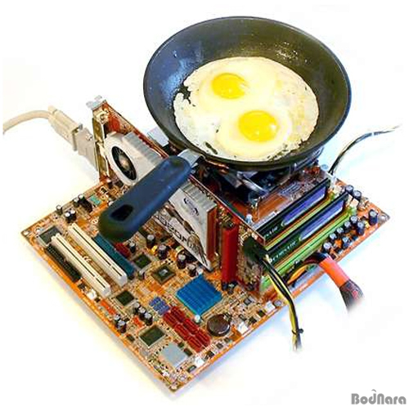

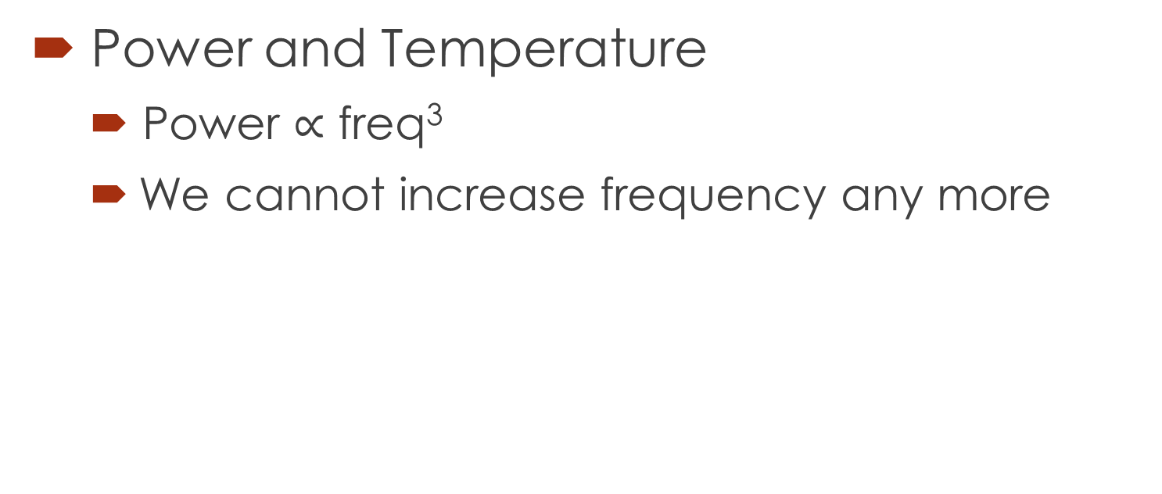
What stopped gains in processor performance?
Power and Temperature
Power $∝$ freq³
We cannot increase frequency any more
This Photo by Unknown Author is licensed under CC BY-NC-ND

Slide 35

What else?
IPC
Diminishing returns ...
Hard to handle localized temperature hot spots
Compiler Optimizations
Again diminishing returns ...
Single core computer architecture is dead
This Photo by Unknown Author is licensed under CC BY

Slide 36
New Mantra: Think parallel
Typical design of a multicore CPU
Cores
Cache banks
Memory
controller
Other
circuitry

Slide 37
What are the new problems to be solved ...
Designing a parallel system
Writing a parallel program
Convert existing algorithms into parallel algos. or write new ones
Design of parallel architectures
Ease of programmability
Sending messages between cores and cache banks effectively in such a system

Slide 38
What about old friend power?
Tradeoff
Performance per core
Number of cores
Frequency of each core
We can afford to have many low frequency cores
As a result frequencies have come down in the past decade

Slide 39
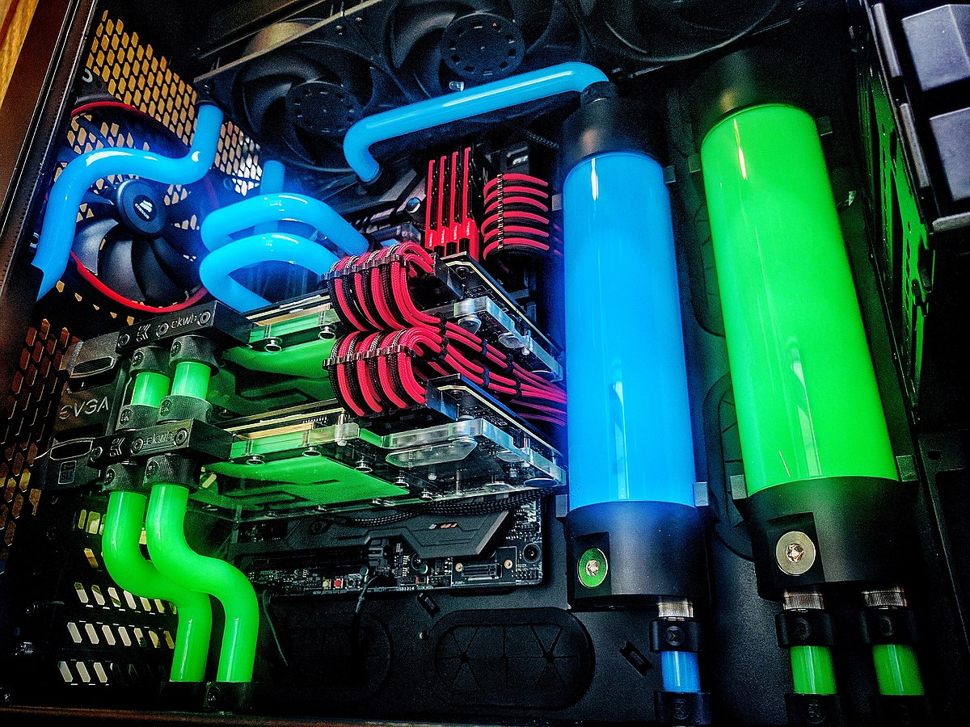
Novel methods of cooling → Water cooled server
This Photo by Unknown Author is licensed under CC BY-SA

Slide 40
Process Variation
Can you do fine grained calligraphy with a blunt knife → NO
Then, how can you design 14nm transistors with 193nm (wavelength) light?

Slide 41
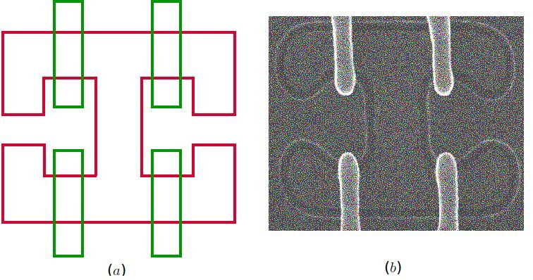
This is what you get ...
bent, deformed shapes in silicon
(courtesy: IBM Microelectronics)

Slide 42
Process Variation Effects
Cannot accurately fabricate transistors anymore
Their power, and performance vary from specifications
Need to have a lot of error tolerance and timing margins
Create new variation tolerant architectures

Slide 43

Reliability: Soft Errors and Hard Errors
Let us ask some questions:
We all know that it takes a lot of money to cool a super-computer. Why not place it on top of the Himalayas? No cooling required.
If I run a processor continuously for 10 years. What happens?

Slide 44
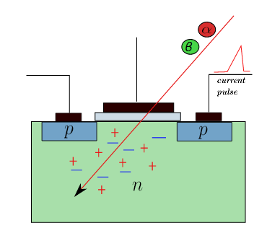
You cannot place a supercomputer on mount Everest.
The processor will be bombed by cosmic rays
The resultant current pulse can flip bits

Slide 45
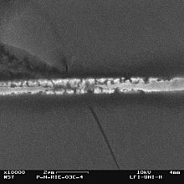
What happens after 10 years of continuous operation ...
This Photo by Unknown Author is licensed under CC BY-SA
This is what happens to a wire after that many years → Electromigration
Designs should be tolerant to such ageing mechanisms

Slide 46
Security: The kill switch (HW Trojan)
September 2007: Israeli jets bombed a Syrian nuclear facility.
The Syrian radar had mysteriously stopped, but why?
Scoop: Israelis sent a wireless message to the processor in the radar.
It shut itself off.
Research problem: How do you make a design tolerant to hardware Trojans.

Slide 47
Past
Present
Future

Slide 48

Transistor Size Roadmap
Year | Transistor Size
2016 | 14 nm
2018 | 10 nm
2020 | 7 nm
2022 | ???
It is not possible (?) to design such small transistors with current technologies.
7 nm = 70 atoms wide

Slide 49
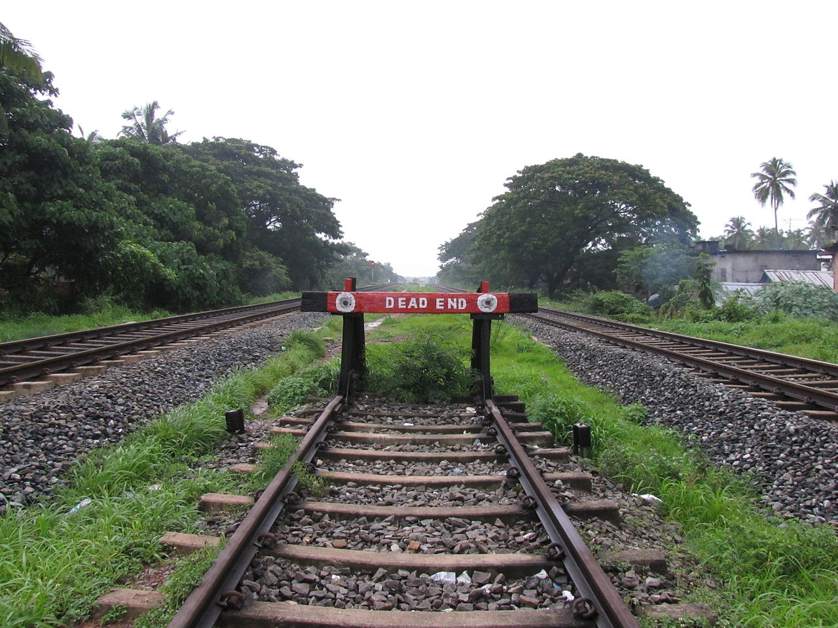
What next?
No Silicon
This Photo by Unknown Author is licensed under CC BY-SA

Slide 50
Future of Computer Architecture
Graphene – Sheet of carbon (1 atom wide)
Spintronics – Based on the spin of the electron
Quantum Computing – Store information as qubits → multiple bits at once
Instead of electrons use photons (light)

Slide 51

Discussion on Teaching Computer Architecture
This Photo by Unknown Author is licensed under CC BY-SA-NC

Slide 52
Contents of a basic course
Elements of a computer architecture course
Boolean Algebra
Assembly Languages
Digital Logic
Representation of Numbers, Strings
ARM
Computer Arithmetic
x86
Basic Course 1

Slide 53
Contents - II
Elements of a computer architecture course
Processor Design
Memory Systems
Multiprocessors
Pipelining
Caches
I/O Systems
Main memory
Basic Course 2

Slide 54

Advanced Topics
Out-of-Order
Pipelines
Theory of Memory
Models
Security and
Low Power
GPUs
Caches and
Main Memory
Processors for
Machine Learning
Available worldwide in stores in 2021.
Google books, Amazon, Flipkart.

Slide 55
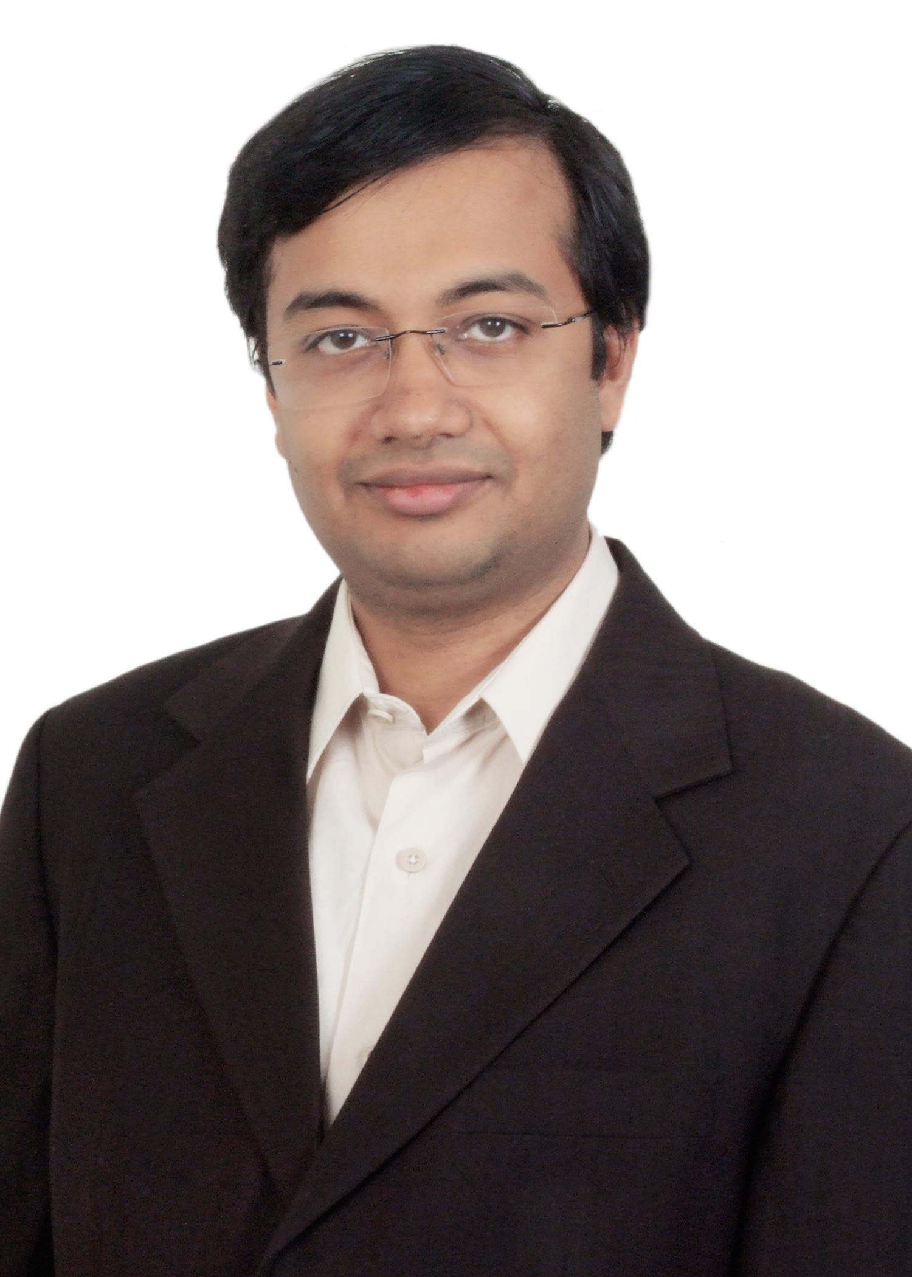

Thank You
srsarangi@cse.iitd.ac.in

